Slide 1
Beer Data Challenge- Assignment
By-
Himani Attri

Slide 2
Beer Data Questions-
Rank top 3 Breweries which produce the strongest beers?
Which year did beers enjoy the highest ratings?
Based on the user’s ratings which factors are important among taste, aroma, appearance, and palette?
If you were to recommend 3 beers to your friends based on this data which one will you recommend?
Which Beer style seems to be the favorite based on reviews written by users?
How does written review compare to overall review score for the beer styles?
How do find similar beer drinkers by using written reviews only?

Slide 3
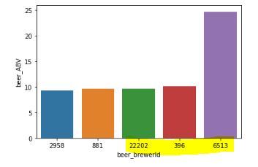
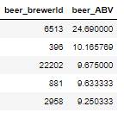
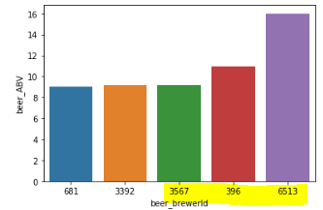
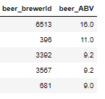
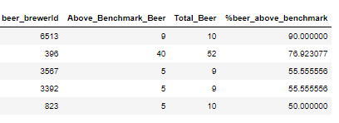
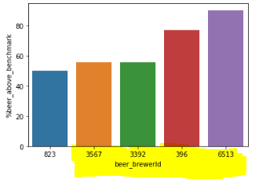
Q1. Rank top 3 Breweries which produce the strongest beers?
Top 5 Brewer IDs as per
avg ABV%
Top 5 Brewer IDs as per
median ABV%
Being a Non-Beer drinker myself, took while to research that Alcohol by Volume (ABV) is a measurement of the alcohol content and getting a feel of the data.
We will be using this as a metric to decide which breweries produce the strongest beers.
Checks considered-
We can see on an average, a brewery produces ~10 beers and median is ~5 beers.
We will be considering breweries who produces more than 5 beers for our required analysis.
Consolidating every approach-
Answer-
1. Brewer_id 6513 --Avg ABV 24% --Med ABV 16% --90% beers they make are above our benchmark 9% ABV
2. Brewer_id 396 --Avg ABV 10% --Med ABV 11% -- 76% beers they make are above our benchmark 9% ABV
3. Brewer_id 3392 --Avg ABV 10% --Med ABV 9% -- 55% beers they make are above our benchmark 9% ABV
The above Brewer produces the strongest beers.
Top 5 Brewer IDs basis %age of beers above 9% ABV benchmark

Slide 4
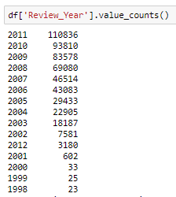
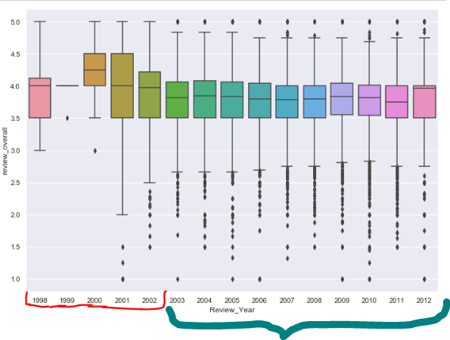
Q2. Which year did beers enjoy the highest ratings?
Reviews received yearly Distribution
Converted Unix Time Stamp to proper readable date format as the review time present in data is not in readable form.
Checks considered-
There is no point in considering any year less than 2002 as there were no significant reviews at that time.
Taking into consideration those beers only which have reviews greater than 10 in a year as avg reviews per beer yearly came out to be ~10.
Consolidating approach-
From below plot we can see that-
Ans-
Considering year greater than 2002 where significant reviews were available, 2012 is the year which is having good review overall as we can see from the median box plot spread. It’s median value of overall score is max compared since 2003.
Distribution of overall Score at a yearly level

Slide 5
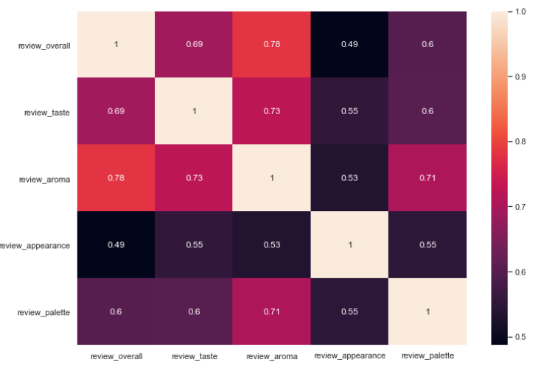
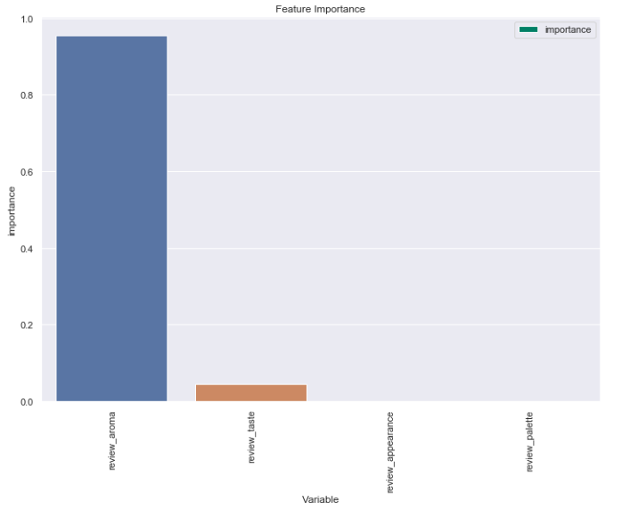
Q3. Based on the user’s ratings which factors are important among taste, aroma, appearance, and palette?
Correlation Matrix
Approach 1:
Correlation between taste ,aroma, appearance and palette can be checked with overall score.
Conclusion from 1:
Highest Correlation exists between Overall Score & aroma then overall & taste then overall + palette then overall + appearance
It seems to be the order Aroma> Taste > Palete > Appearance
Approach 2:
A regression model can be applied, and we can extract feature importance from there as well. Applying a simple decision tree in here.
Conclusion from 2:
From here as well, we can see Aroma & Taste hold more importance than other metrics.
Feature Importance of Aroma, taste, palete and appearance

Slide 6
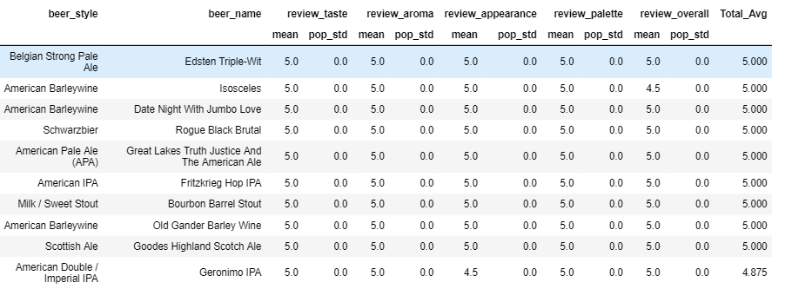
Q4. If you were to recommend 3 beers to your friends based on this data which one will you recommend?
Average of Aroma, taste, appearance and Palete, with deviation in place
Check-
We are aware from before analysis that on an average we receive 12 reviews per beer and we can also see a user gives on an average 12 reviews.
So, we will be working on the subset of data where beers have more than 12 reviews and users also have given more than 12 reviews so that it makes more sense to recommend beers basis that info.
Approach 1:
Considering Overall grouping average of Aroma, taste, apperance, palette for reaching the conclusion
If user has preference for aroma & appearance then they will like beer that score highly in the review_aroma and review_appearance variables.
Along with the average we can keep in mind the standard deviation as well. It will help in generalizing.
Approach 2:
Recommending beer depend upon the preference of a user,
Also, we have ranked top beers in different beer styles basis the average scores in aroma, palette, appearance, taste
If a particular beer style is a preference, then top 3 beers from that category can be picked up.

Slide 7
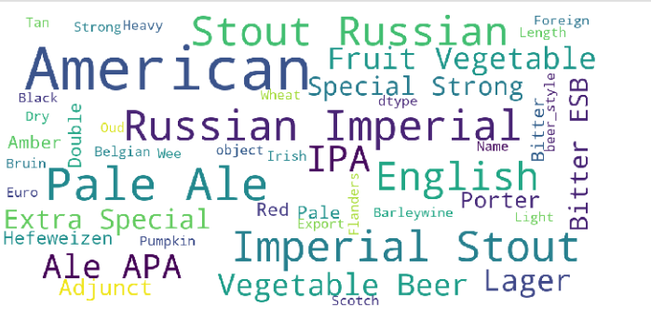
Q5. Which Beer style seems to be the favorite based on reviews written by users?
Beer Styles word cloud as per positive sentiments in text reviews
Check-
Removing observations where review_text is blank
Approach-
Perfoming sentiment analysis on the review_text available
Categorizing into positive, neutral & negative comment category
Forming word cloud of beer names where the review sentiments are positive
Conclusion-
We can say American seems be be popular beer name among the positive reviews

Slide 8
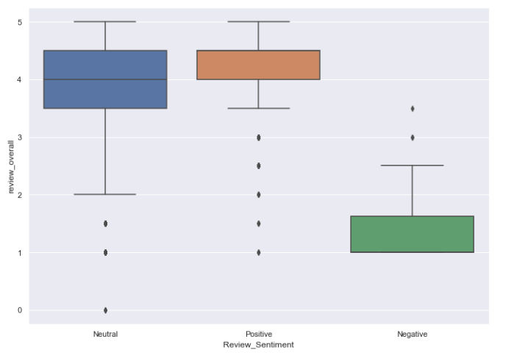
Q6. How does written review compare to overall review score for the beer styles?
Box plot showing distribution of Overall Score with respect to written review sentiments
Check-
Removing observations where review_text is blank
Approach-
With the sentiment analysis on the basis of written review, we categorized reviews in positive, neutral and negative reviews.
Now we can see how the distribution of overall score looks like with the written review sentiment.
Written review sentiments align with the overall scores as well.
We can see that for positive reviews the overall review is at higher side, > 4
For negative reviews the overall review is at lower side
Same can be seen at different beer styles level as well

Slide 9
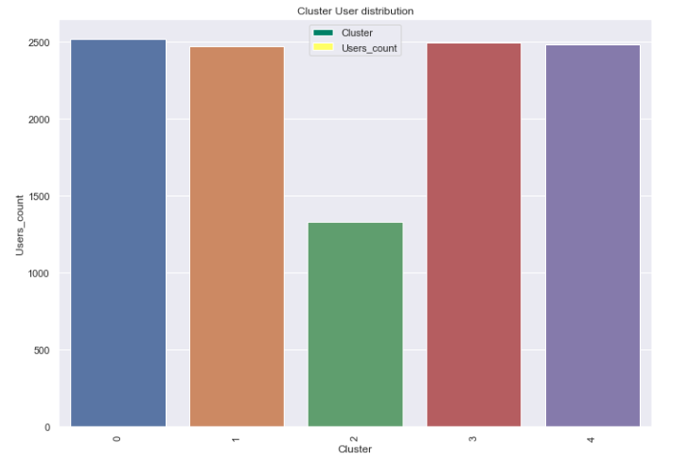
Q6. How do find similar beer drinkers by using written reviews only?
Users grouped in different clusters as per the written reviews
Check-
Subsetting users who has given enough reviews to apply the analysis on.
Considering user data who have given at least 30 reviews.
Also, beers having at least 30 reviews corresponding to them.
Approach-
On the basis of review, we can apply an unsupervised learning algorithm to create clusters of review.
We will create features like tf idf vectors and by using K means we will be able to form clusters of reviews. Those clusters will be having similar behaviors of user set.

Slide 10
Thank you!

